Slide 1
Superstore Sales Dashboard
Data Visualization & Storytelling using Power BI
By
Dhana Lakshmi Kotupalli

Slide 2
Project Overview
Objective: Analyze Superstore sales to uncover trends and insights.
Tools Used: Power BI, Excel
Dataset: Superstore (Sales, Profit, Region, Category, Time)
Deliverable: Interactive Dashboard + Visual Summary

Slide 3
KPIs Overview (with Screenshots)
KPI Cards Used:
Total Sales
Total Profit
Profit Margin
Quantity Sold
Number of Orders

Slide 4
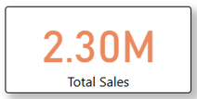
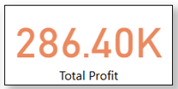

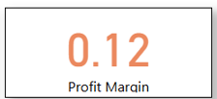
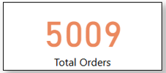
Screenshots of KPI Cards
Total sales: 2.30M Sum of Quantity: 38K
Total Profit: 286.40K Profit Margin: 0.12
Total Orders: 5009

Slide 5
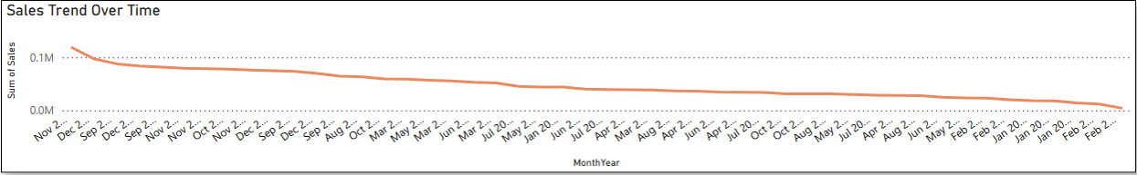
Sales Trend Over Time
Line Chart Screenshot (Monthly Sales using Date Table)
Insight: Which months/quarters have highest and lowest sales
Business takeaway: Optimize marketing before peak months

Slide 6
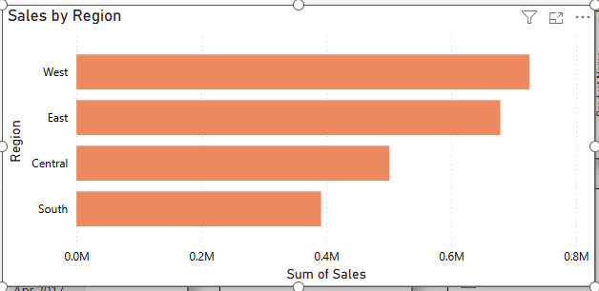
Sales by Region
Map or Bar Chart Screenshot
Insight: West has highest sales, South lags behind
Suggestion: Target low-performing regions with better pricing or promotions

Slide 7
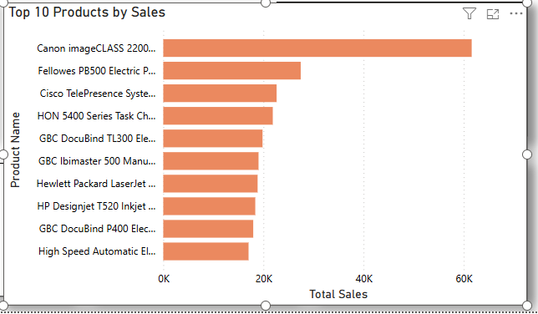
Top-Selling Categories or Products
Bar Chart of Top 10 Products or Sub-Categories
Insight: Top contributors to revenue
Note if any low-profit products still sell well

Slide 8
Profit vs Discount Analysis
Scatterplot or Combo Chart
Insight: High discount may not lead to high profit
Suggestion: Adjust discounting strategy

Slide 9
Summary of Business Insights
West region is top-performing
Office Supplies has stable profit margin
Tables sell well but with losses — needs review
December is peak sales month

Slide 10
Conclusion
What We Achieved:
Built an interactive sales dashboard using Power BI
Identified top-performing regions, categories, and time periods
Analyzed KPIs like Total Sales, Profit, Quantity, and Profit Margin
Gained insights into discount effectiveness and product performance

Slide 11
View project on GitHub:
github.com/dhanalakshmik506/Superstore-Sales-Dashboard

Slide 12
THANK YOU

